Slide 1
Stock Market Prediction System with Modular Neural Networks
Neural Networks, 1990., 1990 IJCNN International Joint Conference on
Publication Date: 17-21 Jun 1990
On page(s): 1-6 vol.1
Presenter: Tsung-Jung Tsai (蔡宗容)
Date: March 12, 2008

Slide 2
Abstract (1/2)
This paper discuses a buying and selling timing prediction system for stocks on the Tokyo Stock Exchange (東京證券交易所) and analysis of internal representation. It is based on modular neural networks. We developed a number of learning algorithms and prediction methods for the TOPIX (Tokyo Stock Exchange Prices Indexes,東證1部指數) prediction system.

Slide 3
Abstract (2/2)
The prediction system achieved accurate predictions and the simulation on stocks trading showed an excellent profit(獲利). The prediction system was developed by Fujitsu(富士通證券) and Nikko(日光證券) Securities.

Slide 4
Introduction to Stock Index
日本東證1部指數 (Tokyo Stock Exchange Prices Indexes) 為日本主要股票指數之一，成分股包括1719家上市企業，總市值達469.8兆日圓。
日經指數(Nikkei Stock Average)，成分股僅225家上市公司，總市值313兆日圓，一般而言，市場多以日經指數為日股走勢主要指標。

Slide 5
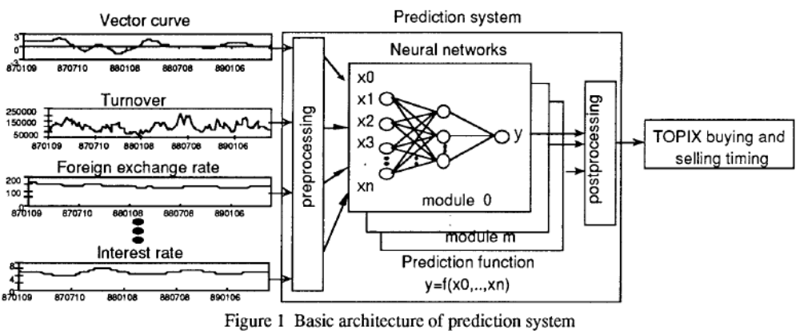
System Overview
The goal is to predict the best time to buy and sell
for one month in the future.

Slide 6
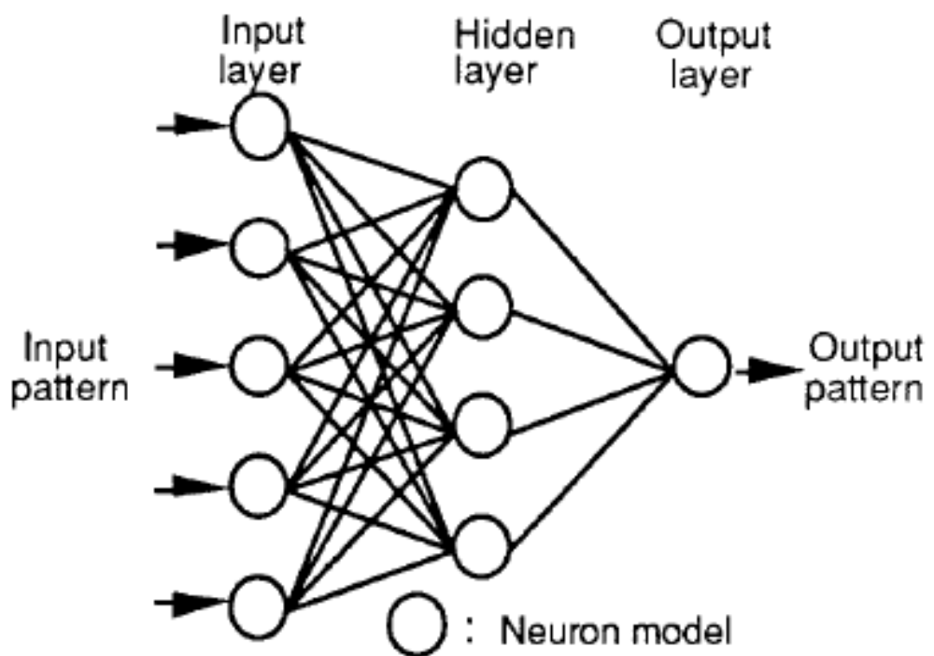
Neural Network Model

Slide 7
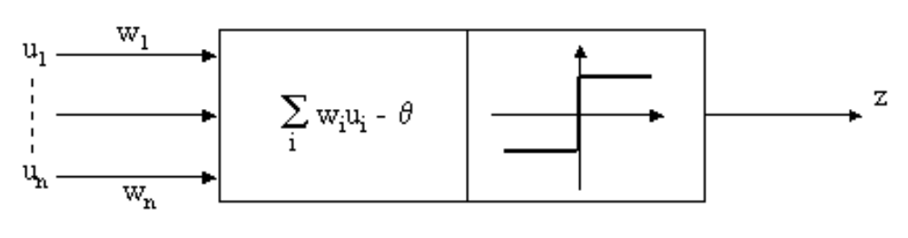
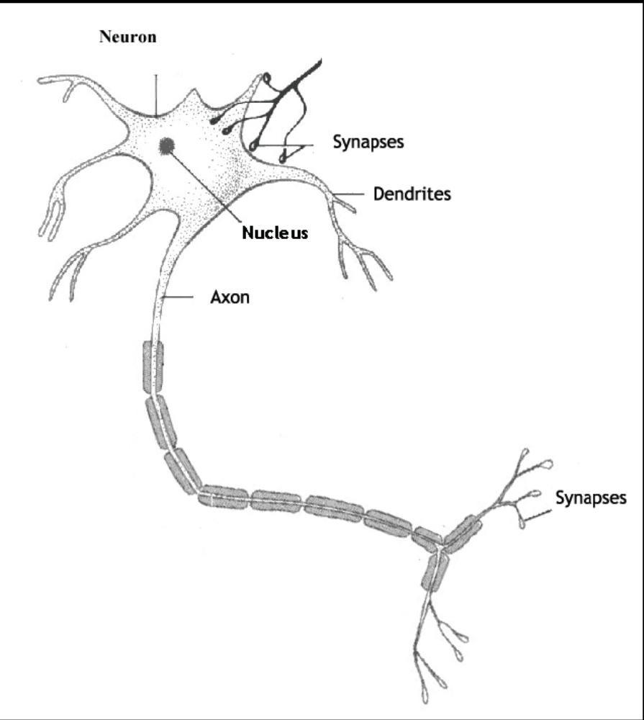
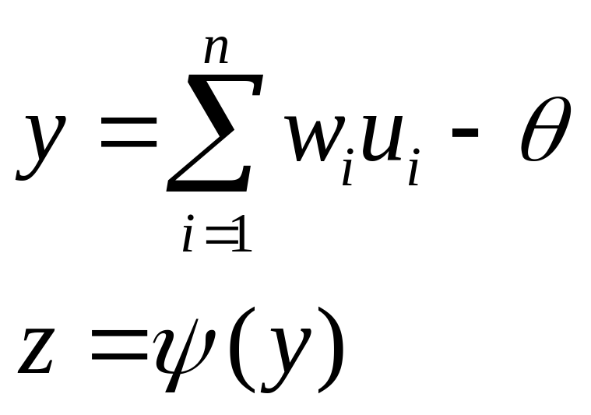
Z is either continues or binary valued
Depending on the activation function
Notes:
其中 y 是淨輸入，z 是活化函數

Slide 8
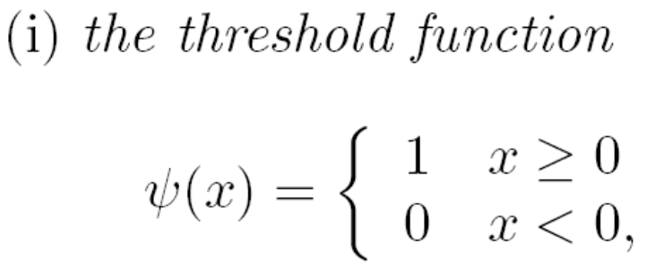
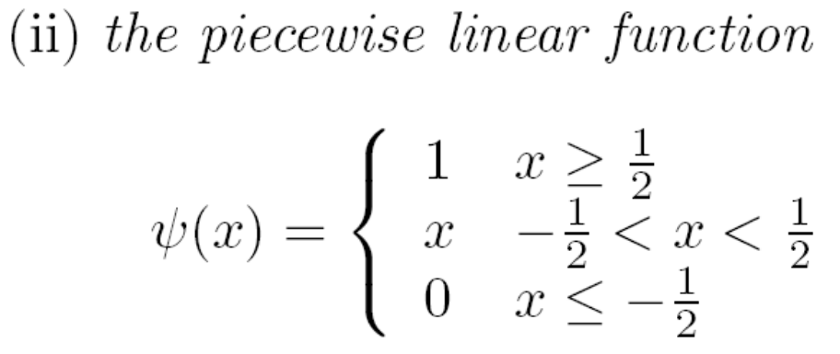
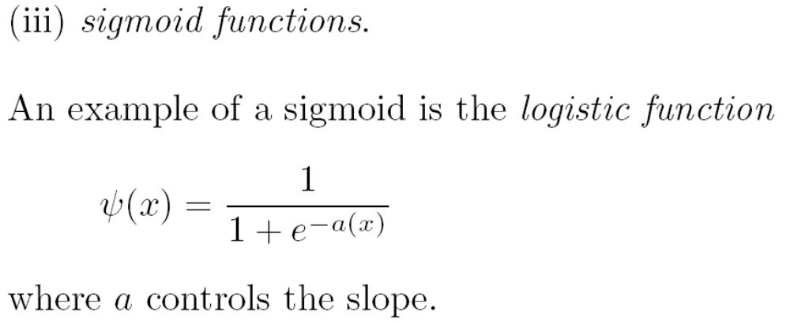
Activation Functions (1/2)
Notes:
最受歡迎的

Slide 9
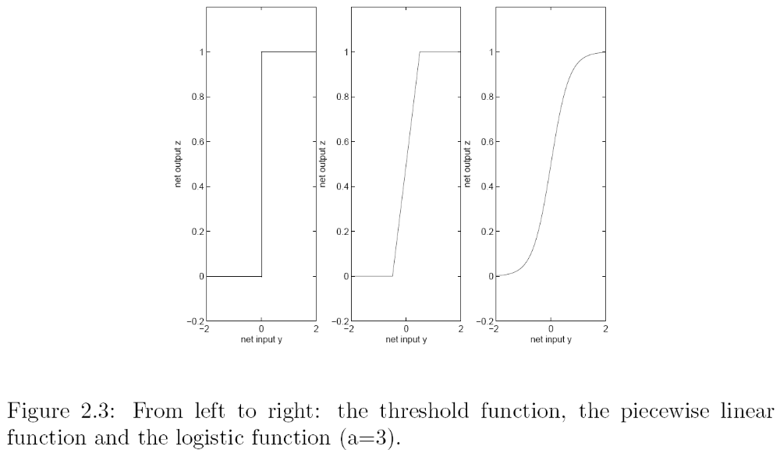
Activation Functions (2/2)

Slide 10
High-speed Learning Algorithm
The error back propagation method is a representative learning rule for hierarchical networks.
Supplementary learning, based on the error back propagation, automatically schedules pattern presentation and changes learning constants.
In supplementary learning, the weights are updated according to the sum of the error signals.

Slide 11
High-speed Learning Algorithm
The weight factor is updated as follow:
Where
ε: learning rate α: momentum
learning_patterns:
number of learning data items that actually require error back propagation.1

Slide 12
Learning Data – Data Section
We believe stock prices are determined by time-space patterns of economic indexes
such as foreign exchange rates and interest rates and of technical indexes such as curves and turnover.
Using a moving average of weekly average data of each index for minimizing influence due to random walk.

Slide 13
Input indexes
Vector curve
Turnover
Interest rate
Foreign exchange rate
New York Dow-Jones average
Others

Slide 14
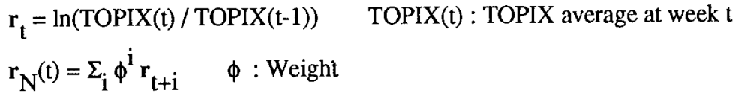
Teaching Data
The TOPIX weekly return is r_{i}, teaching data r_{N}(t) is defined as:

Slide 15
Preprocessing
Input indexes converted into space patterns and teaching data are often remarkably irregular.
Such data is preprocessed by log or error functions to make them as regular as possible.
normalization

Slide 16
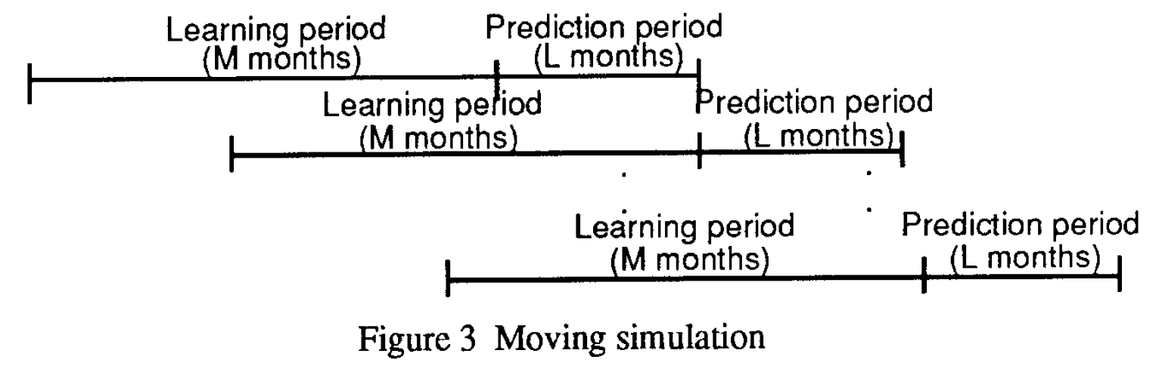
Moving Simulation

Slide 17
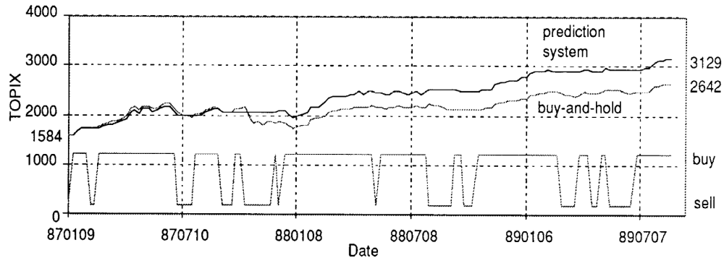
Simulation for Buying and Selling Simulation

Slide 18
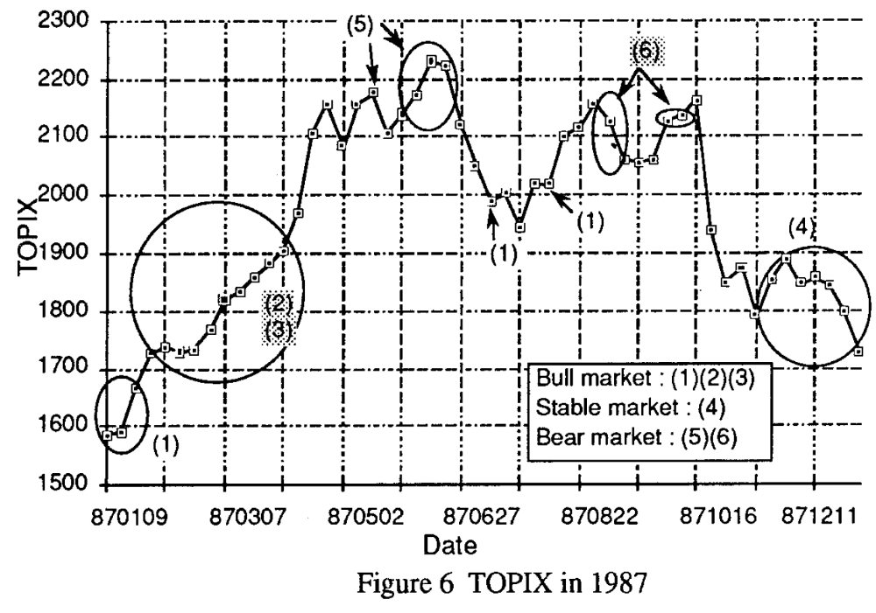

Slide 19
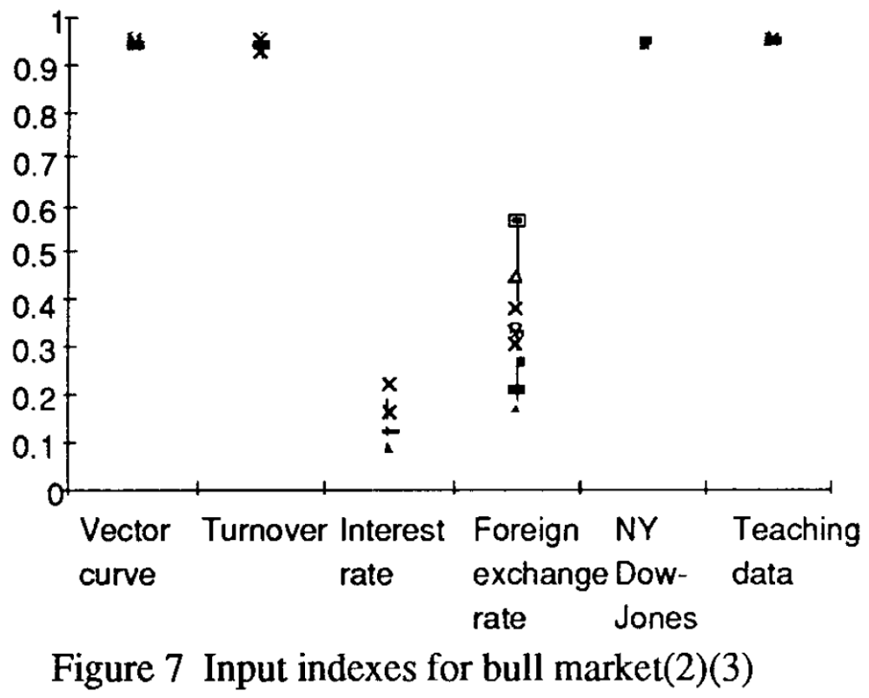

Slide 20
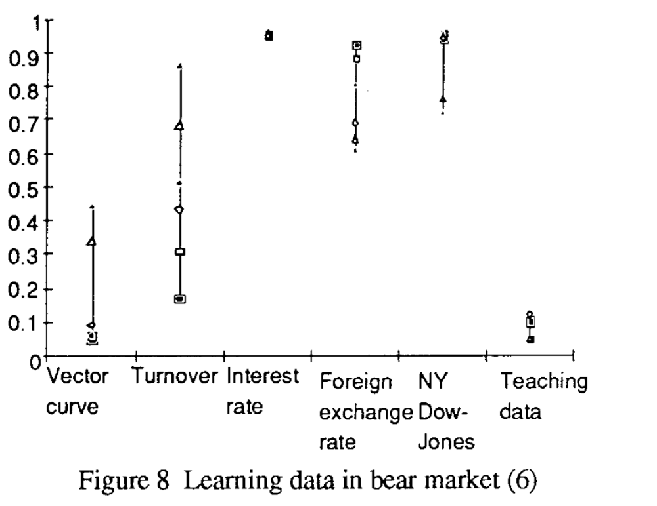

Slide 21
